Slide 1


HDSB’s (Elementary) Math Direction 2013-2014
Ruth Teszeri
Instructional Program Leader
Notes:
Thank you for inviting me to share . . .

Slide 2
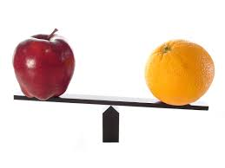
Notes:
I’m here today as the result of a casual conversation a few weeks ago with one of our board’s research team members, Tim Sadai. Tim asked me what my opinion was on the similarities and differences between the learning and teaching of literacy and mathematics. Our conversation included the differences between the Language and Mathematics curriculum content as well as skill sets for both. One of his key questions was: “Can we take what we have done to improve achievement in reading and writing, and apply the same strategies or process to mathematics? Why or why not?” Turn and talk – What do you think are the differences between Language and Mathematics – curriculum, learning, teaching?

Slide 3


Slide 4
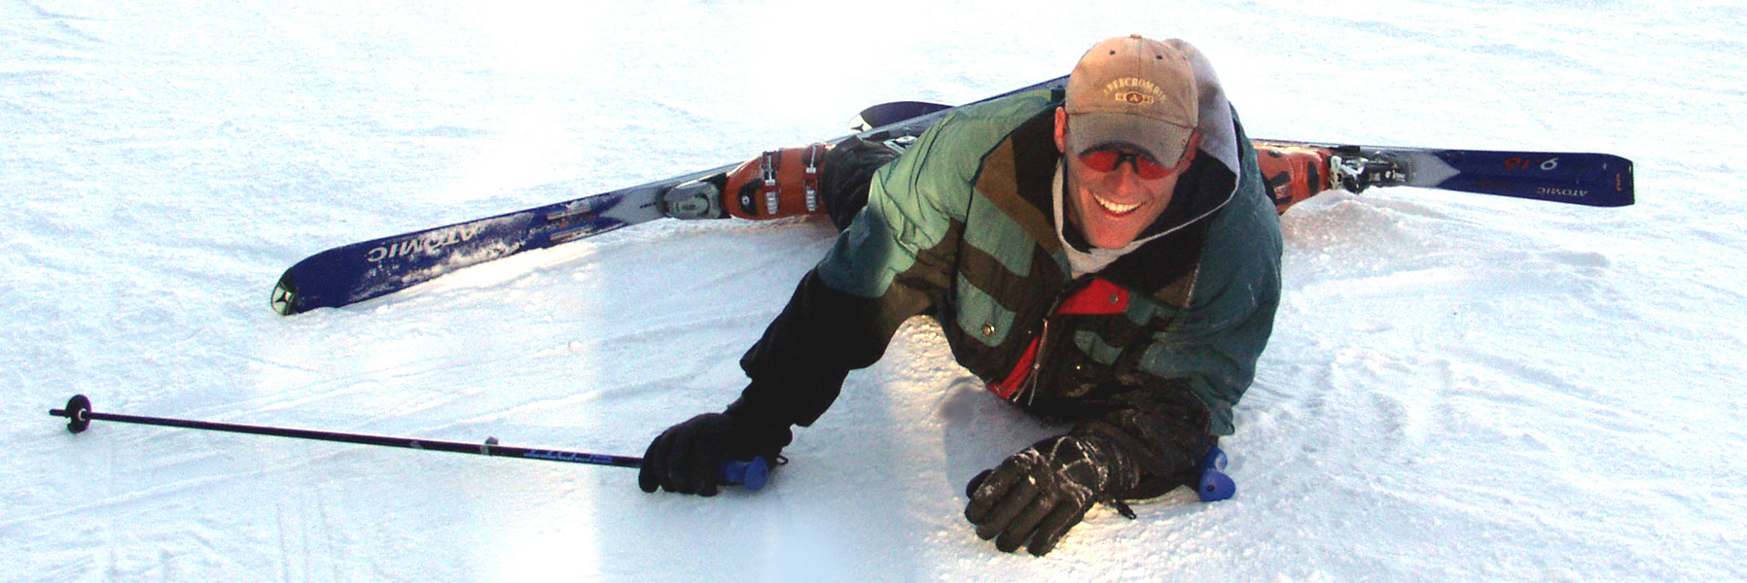
Notes:
Learn from the past

Slide 5
CIIM Research Report - 2007
Notes:
Suurtamm, C. & Graves, B. (2007). CIIM: Curriculum Implementation Intermediate Math Research Report, http://www.edu.gov.on.ca/eng/studentsuccess/lms/files/CIIMResearchReport2007.pdf

Slide 6
Collaborative Inquiry for Learning Mathematics (CIL-M) – External Review (2011)
Value in the core features of the CIL-M
Sharpening the focus on mathematics
Notes:
Bruce, C., Ross, J., Flynn, T. & Lessard, G. (2011). Report on the external review of the collaborative inquiry for learning in mathematics (CIL-M) project: Year 3. Literacy and Numeracy Secretariat, Toronto, Canada.

Slide 7
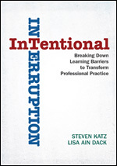

Notes:
Dr. Katz & Dr. Dack’s work - common learning between Superintendents, Administrators and School Programs staff:
Inquire about something you really want to know about - what puzzles you
Focus inch-wide, mile-deep
Dr. Donohoo’s work – common learning between School Programs and Student Services
- Sharpening our protocol for developing collective inquiry questions and theories of action
Katz, S. & Dack, L.A. (2013). Intentional interruption: Breaking down learning barriers to transform professional practice. Thousand Oaks, CA: Corwin Press.
Donohoo, J. (2013). Collaborative inquiry for educators: A facilitator's guide to school improvement. Thousand Oaks, CA: Corwin Press.

Slide 8
HDSB’s Own Internal Review/Data
Early Primary Collaborative Inquiry (EPCI)
Collaborative Inquiry in Mathematics (CIL-M)
System Implementation and Monitoring (SIM)
Middle Years Collaborative Inquiry (MYCI)
[+ previous OFIP + SIM initiatives history]

Slide 9
Common Exit Pass – 3 Initiatives
Relevance: Overall, the focus of this learning was relevant to me in my role.
Knowledge: I am more knowledgeable as a result of this learning.
Application of learning: I feel able to apply aspects of the learning in my role/practice.
Belief in the benefit to students: I believe that students will benefit as result of this learning.
Self-confidence: I feel confident in applying aspects of the learning in my role.
Support: I know how to access support/feedback as I apply the learning in my role/practice.
RESEARCH DEPARTMENT
Notes:
The exit pass gathered feedback on the level of participants’ agreement with six variables using an agreement scale where 1 represented strongly agree and 6 represented don’t know.

Slide 10
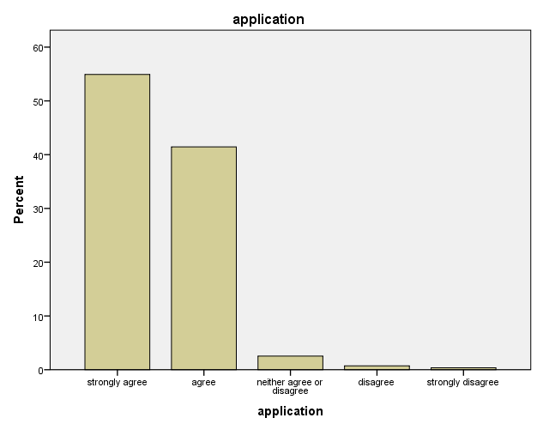
Application of Learning:
I feel able to apply aspects of the learning in my role/practice.

Slide 11


What Are Other Boards Doing? Why?
Notes:
What are the great pieces of their work that we can integrate into what we are doing?

Slide 12
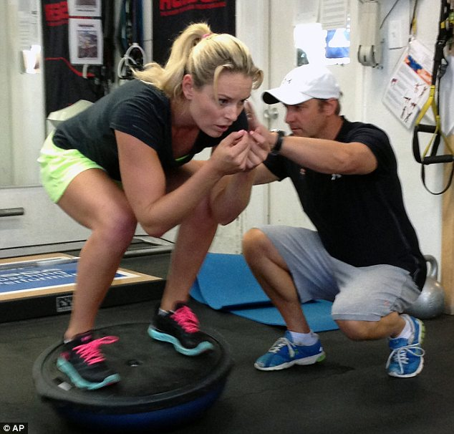
Notes:
Live n the present

Slide 13
Direction for Math in Halton
How do we assess for learning in math?
Making Student Thinking Visible
(students’ work + students at work)
WHAT
HOW
Curriculum
Effective Guides/TIPS4RM/Edugains
What does the expectation really mean?
What CAN students do?
Where do they need to go next?
How will teachers respond to move them forward?

Slide 14
Direction for Math in Halton
“All I really need to know I learned in kindergarten.” - Robert Fulghum
Check it out – FDELK draft curriculum, pg. 25
RESPONDING/CHALLENGING/EXTENDING
How Do Teachers Respond to Move Students Forward?

Slide 15
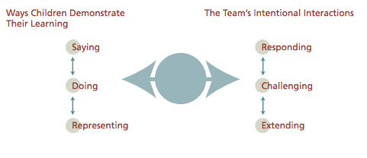
Notes:
Draft FDELK Curriculum – pg. 25

Slide 16
Direction for Math in Halton
RESPONDING
CHALLENGING
EXTENDING
How Do Teachers Respond to Move Students Forward?
Anticipate
Recognize
Name It
Strategic Instructional Decisions
Effective Descriptive Feedback
Consolidation
Connecting
Notes:
Anticipate - teachers DO THE PROBLEM to determine multiple ways students will respond to a problem (including misconceptions)
Name it - name the mathematics that is anticipated (e.g., rate, unit rate, proportion) based on the curriculum expectation - name it - what can they do? (need to be able to recognize it first)
Recognize it - identify the mathematics in student’s written or oral responses
Strategic decisions - the ability to respond to where students are (e.g., use a rate) to move them forward (e.g., use a unit rate) - what are the strategic instructional decisions you need to make to move them to the next step/level?
Effective descriptive feedback - What is written on student work? “Good job” lacks the feedback students need...what CAN they do, where should they go next?
Consolidation - beyond the “show and tell” (e.g., used a table, used a graph, everyone shares)...What is the mathematics drawn out at the “end of the day” What do we want students to consolidate? What are students consolidating? How do we know? What will we do about it?
Connecting - ensuring that the consolidation connects to a bigger idea

Slide 17
Direction for Math in Halton
How do we assess for learning in math?
Do we believe that all students can be successful in mathematics?
Content Knowledge for Teaching and Learning Mathematics
Making Student Thinking Visible
(students’ work + students at work)
WHAT
HOW
Curriculum
Effective Guides/TIPS4RM/Edugains
How Do Teachers Respond to Move Students Forward?
Notes:
- both require content knowledge for teaching and learning mathematics

Slide 18
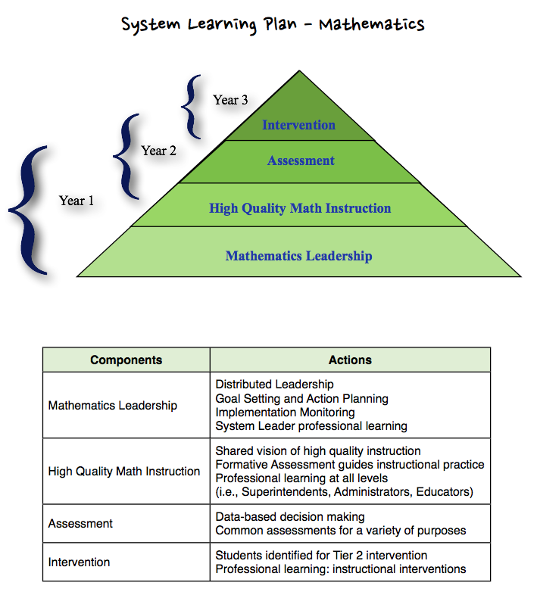
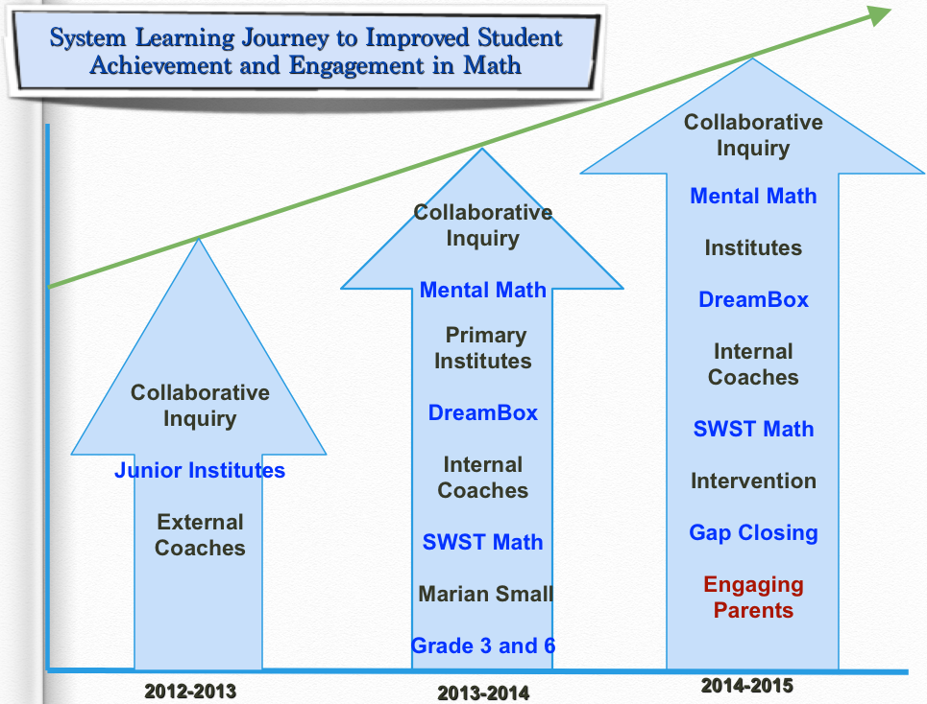
What’s the plan?

Slide 19
What’s the plan?

Slide 20
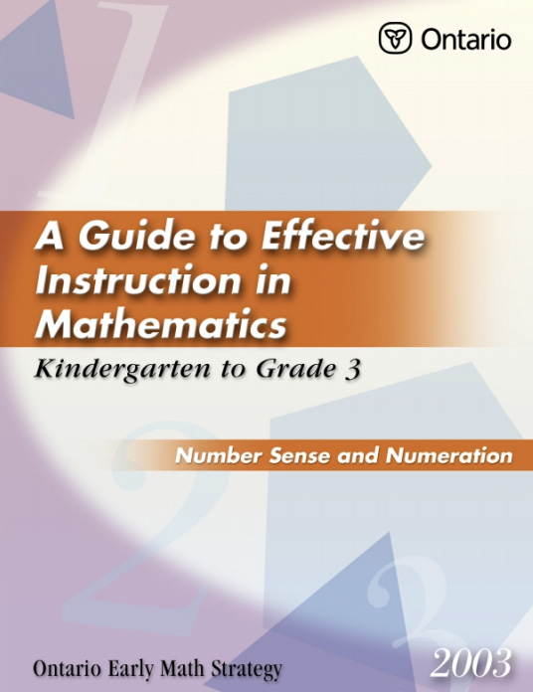
What’s the plan?

Slide 21

What’s the plan?

Slide 22
Direction for Math in Halton
How do we assess for learning in math?
Do we believe that all students can be successful in mathematics?
Making Student Thinking Visible
(students’ work + students at work)
WHAT
HOW
Curriculum
Effective Guides/TIPS4RM/Edugains
How Do Teachers Respond to Move Students Forward?
Notes:
All of these incorporate both of these 2 key foci

Slide 23
HDSB Math Initiatives/Inquiries (Some)
MYCI (6), 7 to 10
Collaborating with Congress - 1-3, 4-6, 5-7
Mental Math - Primary, Junior
PRIME Patterning & Algebra
DreamBox
Funding Sources:
EPCI
CIL-M
MYCI
School Board

Slide 24
HDSB Math Initiatives/Inquiries (Some)
Middle Years Collaborative Inquiry - (6), 7 to 10
Collaborating with Congress - 1-3, 4-6, 5-7
Mental Math - Primary, Junior
PRIME Patterning & Algebra
DreamBox

Slide 25

DreamBox
Using DreamBox as:
a conversation starter?
lead to classroom practice?
new ideas/models to explore?
resource? (All of us)
Flexibility
Notes:
Adaptive software – influenced by work of Cathy Fosnot

Slide 26
PRIME Patterning & Algebra
20 schools
2 days of training - February & March
2 teachers per school
Notes:
Using resources we have

Slide 27
HDSB Math Initiatives/Inquiries (Some)
Middle Years Collaborative Inquiry - (6), 7 to 10
Collaborating with Congress - 1-3, 4-6, 5-7
Mental Math - Primary, Junior
PRIME Patterning & Algebra
DreamBox

Slide 28
Math Inquiry – A Typical Day
Periods 1 & 2 – Unpacking curriculum &
co-planning
Period 3 – In the classroom – Activating & developing student thinking
Period 4 – Debriefing/co-planning
Period 5 – In the classroom – Consolidating student thinking
Period 6 – Debriefing & planning next steps
Notes:
Are modifying the model this year – removing upfront learning in periods 1 & 2 to provide more time for anticipating the math, naming it, discussing its continuum (if any) . . .

Slide 29
Middle Years Collaborative Inquiry (MYCI)
~ 6 release days/teacher - 1 now + 5 Term II
5 hubs:
4 high schools
16 elementary schools

Slide 30
Middle Years Collaborative Inquiry (MYCI)
Examples of last year’s inquiry foci:
If students are exposed to problems with real life contexts and multiple entry points, then they will make connections, be more proficient explaining their thinking and be more engaged.
If we use math talk and student inquiry in a collaborative group setting, then students will be more engaged in math and will persevere to problem solve successfully.

Slide 31
Middle Years Collaborative Inquiry (MYCI)
Examples of this year’s inquiry questions:
What is the impact of refining the use of consolidation strategies on how students communicate their thinking and understanding?
How do we help students improve their ability to justify the logic or reasonableness of their mathematical thinking?
Notes:
Note the influence of Katz & Dack’s work and Donohoo’s

Slide 32
Collaborating with Congress
3 Sections:
1-3 - Addition and Subtraction
4-6 - Multiplication and Division
5-7 - Fractions, Decimals, and Percents
* ~ 3 hubs in each
*3 teachers per school
*4 release days - 0.5 Jan + TBD
Notes:
Collaboration with and learning from other school boards
DSBN - what a unit might look like with math congress versus popcorn CILMs with different units
- increased ability to look at assessment and evaluation
- what other experiences/tasks might children need
- what learning will you take from this to other units - e.g., I have to do the math before hand; (aligns with our focus on anticipating the math) variety of strategies to support students
- Cathy Bruce - how much more effective CILMS were when focused on specific content - can buld in the other pieces but through the content

Slide 33
Mental Math
2 sections:
Primary
Junior
* ~ 3 hubs in each
*2 teachers per school
*6(?) release days - 1.0 Jan + 0.5/month
Notes:
Strings – DSBN story of grade 4-5 class -lot of gaps and anxiety around mathematics couldn’t add in Sept and by end of yr were mentally multipying 3-digit by 2-digit numbers

Slide 34
Direction for Math in Halton
How do we assess for learning in math?
Do we believe that all students can be successful in mathematics?
Making Student Thinking Visible
(students’ work + students at work)
WHAT
HOW
Curriculum
Effective Guides/TIPS4RM/Edugains
How Do Teachers Respond to Move Students Forward?
Notes:
- both require content knowledge for teaching and learning mathematics

Slide 35
Direction for Math in Halton
RESPONDING
CHALLENGING
EXTENDING
How Do Teachers Respond to Move Students Forward?
Anticipate
Recognize
Name It
Strategic Instructional Decisions
Effective Descriptive Feedback
Consolidation
Connecting
Notes:
Anticipate - teachers DO THE PROBLEM to determine multiple ways students will respond to a problem (including misconceptions)
Name it - name the mathematics that is anticipated (e.g., rate, unit rate, proportion) based on the curriculum expectation - name it - what can they do? (need to be able to recognize it first)
Recognize it - identify the mathematics in student’s written or oral responses
Strategic decisions - the ability to respond to where students are (e.g., use a rate) to move them forward (e.g., use a unit rate) - what are the strategic instructional decisions you need to make to move them to the next step/level?
Effective descriptive feedback - What is written on student work? “Good job” lacks the feedback students need...what CAN they do, where should they go next?
Consolidation - beyond the “show and tell” (e.g., used a table, used a graph, everyone shares)...What is the mathematics drawn out at the “end of the day” What do we want students to consolidate? What are students consolidating? How do we know? What will we do about it? - KKZ - anticipating, board writing (naming it), consolidation, highlights/summary
Connecting - ensuring that the consolidation connects to a bigger idea

Slide 36
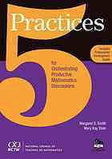
Solidifying Our Anticipating and Consolidation in Problem Solving Math Classes
From:
5 Practices for Orchestrating
Productive Mathematics
Discussions
Notes:
Stein, M. & Smith, M.. (2011). 5 Practices for orchestrating productive mathematics discussions. Reston, VA: NCTM.

Slide 37
Who is working through this process?
Administrators at FOS
Superintendents
Elementary IPLs (all)
Coaches (all)
Collaborative Inquiry in Math (all)
Admin Learning Teams in mathematics
Opportunity for teachers

Slide 38
This book:
is part of planning for the three-part problem-solving lesson
details the planning process AFTER Goal Identification and Task Selection

Slide 39
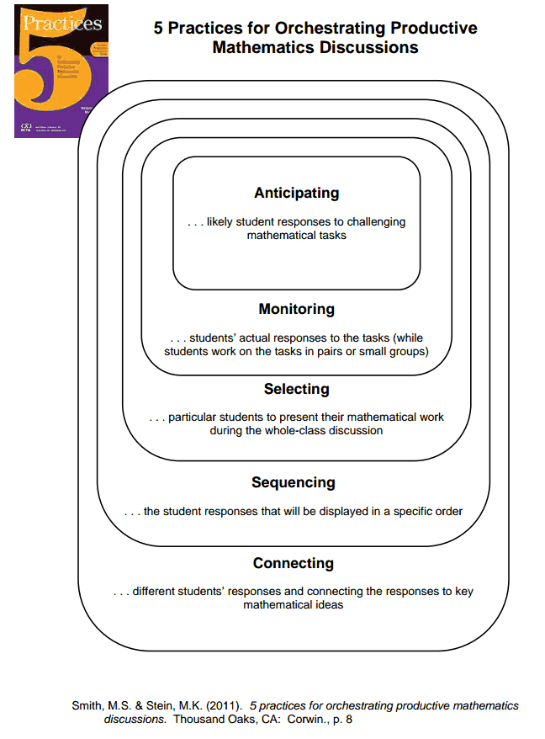
A set of instructional practices - for using student work and students at work, to bring important mathematics to the surface

Slide 40
5 Practices - Anticipation Organizer
Strategy Students Might Use | Key Questions to Ask | Who and What | Order
Notes:
Adapted from the 5 Practices book – will be used in all of HDSBs collaborative inquiry groups this year.

Slide 41
Using Key Resources
Effective Guides for Math Instruction
TIPS4RM (grades 7-12)
Paying Attention to Proportional Reasoning K-12
Big Ideas for Proportional Reasoning K-12
To help you add to your anticipation chart ...
strategies?
thinking tools?
possible misconceptions?
FREE RESOURCES
ANTICIPATING

Slide 42
Solidifying the Consolidation
THE lesson learning goal
Key questions and responses
Highlights/summary

Slide 43
Solidifying the Consolidation
For example . . .
Learning Goal: Using multiplicative thinking for proportional reasoning with rates.
A. Melissa - replicating sets; additive thinking
How did you get your overall answer?
Would you do it the same way if you had more rows to add?
B. Jamal - ratio/rate table; equivalent rates
How did you get the rate of 20:8?
What do you call this representation?
C. Jason - multiplicative reasoning
Can you show me how you “counted by twos”?
How might you use numbers and equations to represent your thinking process?

Slide 44
Highlights/Summary - Example
A rate is a (multiplicative) comparison, or type of ratio,
between 2 quantities with different units.
Rate problems may be solved by:
Replicating sets - growing the rate
Finding/using equivalent rates on a ratio/rate table
Finding and using unit rates
Multiplying using a scale factor
(BUT in students’ words that flow out of their learning from the problem . . . Ask them . . .]

Slide 45
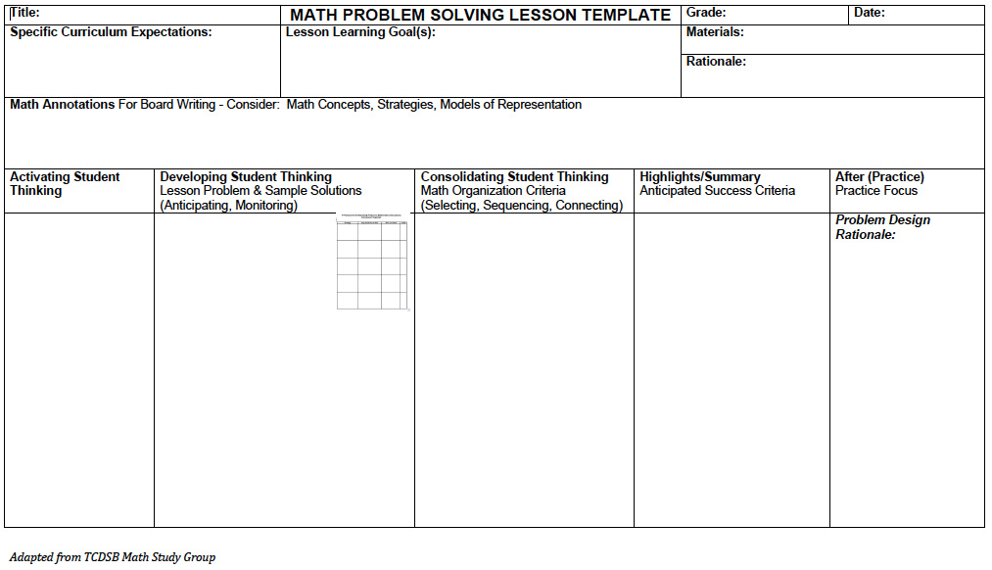
Notes:
Observed the development and delivery of a public research lesson with Toronto Catholic District School Board, Math Study Group, Kathy Kubota-Zarivnij last year.
Changing the lesson plan organizer we are using across Halton District this year, based on TCDSB’s organizer. Will be used by al of our collaborative inquiry groups this year.
KKZ - anticipating, board writing (naming it), consolidation, highlights/summary

Slide 46
Notes:
Still contains the 3 parts of the problem solving lesson

Slide 49
5 Practices - Anticipation Organizer
Strategy Students Might Use | Key Questions to Ask | Who and What | Order

Slide 51
Notes:
Allows for increased focus on what TCDSB calls the “Highlights/Summary.” Our purpose is to help, or at least encourage, teachers and facilitators of collaborative inquires to focus on the math lesson goal by clearly articulating the math learning outcomes, in detail, in advance.

Slide 52
Direction for Math in Halton
RESPONDING
CHALLENGING
EXTENDING
How Do Teachers Respond to Move Students Forward?
Anticipate
Recognize
Name It
Strategic Instructional Decisions
Effective Descriptive Feedback
Consolidation
Connecting
Notes:
Anticipate - teachers DO THE PROBLEM to determine multiple ways students will respond to a problem (including misconceptions)
Name it - name the mathematics that is anticipated (e.g., rate, unit rate, proportion) based on the curriculum expectation - name it - what can they do? (need to be able to recognize it first)
Recognize it - identify the mathematics in student’s written or oral responses
Strategic decisions - the ability to respond to where students are (e.g., use a rate) to move them forward (e.g., use a unit rate) - what are the strategic instructional decisions you need to make to move them to the next step/level?
Effective descriptive feedback - What is written on student work? “Good job” lacks the feedback students need...what CAN they do, where should they go next?
Consolidation - beyond the “show and tell” (e.g., used a table, used a graph, everyone shares)...What is the mathematics drawn out at the “end of the day” What do we want students to consolidate? What are students consolidating? How do we know? What will we do about it? - KKZ - anticipating, board writing (naming it), consolidation, highlights/summary
Connecting - ensuring that the consolidation connects to a bigger idea

Slide 53
Direction for Math in Halton
How do we assess for learning in math?
Do we believe that all students can be successful mathematics?
Making Student Thinking Visible
(students’ work + students at work)
WHAT
HOW
Curriculum
Effective Guides
How Do Teachers Respond to Move Students Forward?
Notes:
- both require content knowledge for teaching and learning mathematics

Slide 54

Notes:
Believe in the future

Slide 56
Ruth Teszeri
Halton District School Board
teszerir@hdsb.ca
Notes:
Thank you for inviting me to share . . .

